Slide 1
Frames, Frameworks, & Foundations in Youth Development Outreach
CYFAR Preconference
2007
Cathann A. Kress
Director, National 4-H Headquarters

Slide 2
Meaning Making
Explore “Frames” for understanding youth;
Explore Frameworks related to youth development and how we use them;
Consider Extension’s role in assisting others to use frameworks in productive ways

Slide 3
Making Information Make Sense
Conservative estimates show information is doubling every three years;
That’s twice as much information every 1,100 days.
In that time, the amount of information you’ll need to ignore, organize, translate, communicate, and build into solutions will double.
Our biggest limitation is no longer our imagination. It is our ability to order, make sense of, and connect everything demanding our attention- how we create clarity.

Slide 4
HOW WE COMMUNICATE MATTERS
As a result, how we share and create knowledge is often more important than what we teach; rather than modeling conformity, we must encourage action on behalf of vision and challenge others to engage in critical thinking, while at the same time offering them the tools with which to do so.

Slide 5
What are Frames?
According to The Frameworks Institute, frames refer to the construct of a communication — its language, visuals and messengers — and the way it signals to the viewer how to interpret and classify new information.

Slide 6
WHAT IS A FRAMEWORK?
A framework is simply a way to organize what is known in an area in order to make it easier for people to use that knowledge effectively.
Makes knowledge easier to use -

Slide 7
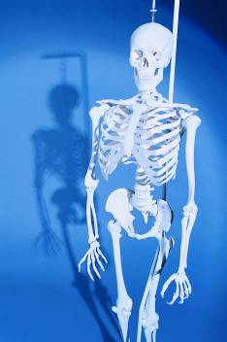
A framework can be considered as the processes and technologies used to solve a complex issue.
It is the skeleton upon which various objects are integrated for a given solution.

Slide 8
CHARACTERISTICS OF FRAMEWORKS
Purpose
Core Elements
Critical Relationships
Underlying Philosophy
Intended Audience

Slide 9
PURPOSE
Some are designed to stimulate research (theories)
Some are designed to communicate to a wide audience
Some are designed to summarize a whole body of literature
Some are designed to guide action
Knowing the intended purpose behind a framework
helps to check its alignment with your intended use.
Frameworks arise not from data so much as purpose.
Notes:
Some are designed to communicate to a wide audience
America's Promise
Some are designed to summarize a whole body of literature
Risk & Protective Factors
Some are designed to guide action

Slide 10
CORE ELEMENTS
Frameworks "boil down" what is known
into simple core elements which capture
the essence and are helpful to the purpose
the framework is trying to accomplish.
Many frameworks use the same research and label core elements differently - this does not necessarily mean they disagree or are incompatible.
Understanding the core elements of a framework are critical to its effective use.

Slide 11
CRITICAL RELATIONSHIPS
In addition to core elements, frameworks describe how elements are related in critical ways to each other or to other concepts
Without an understanding of the relationships a framework posits, it is unlikely to be very powerful.
Sometimes these relationships are more implied than stated.

Slide 12
UNDERLYING PHILOSOPHY
Often less visible but still important to a framework is an underlying way of thinking about the issue which frames the language used.
  Deficit models, for example, talk about risk and prevention while strength-based models emphasize development and growth.

Slide 13
INTENDED AUDIENCE
For whom has the framework been developed?
Whose agenda do they represent?
One of the major problems in using frameworks is that they work differentially well with different audiences.

Slide 14
What We Know
Research has confirmed short- and long-term positive effects of quality youth development programs.
Youth participants in structured developmental programs:
    Have better school attendance, better grades, more positive attitudes towards school, and higher aspirations for the future
    More likely to trust their parents, settle in stable relationships, be employed, report being happy with their lives, and be active in their communities.

Slide 15
However…
Policies and funding are inadequate
Public understanding is limited
These two issues are fundamentally linked to one another.

Slide 16
Additionally…
Within the field, there is confusion about the various frameworks and how they relate

Slide 17
Approaches to Youth Development
PREVENTION
YOUTH DEVELOPMENT
EDUCATION
Focus: Risks & Risk Factors
Target: Social Norms & Communities
Goal: Eliminate or Reduce Problems
Focus: Skills & Knowledge
Focus: Developmental Needs
Target: Individual Learners
Target: Opportunities for Youth
Goal: Competency in knowledge or skill
Goal: Maturity
Notes:
Over the years, our 4-H Educators have used many approaches in their work with youth. Understanding these approaches and how they differ is critical in our effectiveness.
Prevention
Education
Youth Development

Slide 18
Understanding the Different Approaches
Developed by Cathann A. Kress, Ph.D.
EDUCATION
YOUTH DEVELOPMENT

Slide 19
Puberty (physical maturity).
Cognitive (thinking) maturity, when youth can handle abstract concepts.
Social maturity, when youth is able to manage emotions and relationships consistently.
10 11 12 13 14 15 16 17 18 19 20 21 22 23 24 25
Age at which financial independence is reached.
Age at which reasoning centers in brain reach maturity.
Prepared by Cathann A. Kress, Ph.D., National 4-H Headquarters, CSREES, USDA. For more information, contact your county extension office.
The Adolescent Timeline

Slide 21
Content/Context in Youth Outreach
EDUCATION
Mission Areas
YOUTH DEVELOPMENT
Essential Elements
CONTENT
CONTEXT
Belonging
Mastery
Independence
Generosity
Science, Engineering & Technology
Healthy Living
Citizenship
Clubs
School Enrichment
Afterschool
Camps
High Content High Content High Context
Low Context High Context Low Content
Developed by Cathann A. Kress, National 4-H Headquarters, CSREES, USDA
Notes:
Over the years, our 4-H Educators have used many approaches in their work with youth. Understanding these approaches and how they differ is critical in our effectiveness.
Prevention
Education
Youth Development

Slide 22
Content/Context and Life Skills
EDUCATION
Mission Areas
YOUTH DEVELOPMENT
Essential Elements
CONTENT
CONTEXT
Life Skills
Science, Engineering & Technology
Healthy Living
Citizenship
Belonging
Mastery
Independence
Generosity
High Content High Content High Context
Low Context High Context Low Content
Developed by Cathann A. Kress, National 4-H Headquarters, CSREES, USDA
Notes:
Over the years, our 4-H Educators have used many approaches in their work with youth. Understanding these approaches and how they differ is critical in our effectiveness.
Prevention
Education
Youth Development

Slide 23
Analogy for Youth Development
Dale Blyth’s Analogy

Slide 24
A few frameworks…
The 5 C’s
Search Institute’s 40 Assets
Circle of Courage
Brain Architecture
4-H Life Skills Wheel
America’s Promise

Slide 25
YOUR FRAMEWORKS
Consider a framework you regularly use in your work:
  What is the purpose of the framework?
  What are its core elements?
  What are the critical relationships it explains?
  What is the underlying philosophy?
  Who is the intended audience?

Slide 27
Framing “Youth” as a concept
To make meaning out of the complex world, we all use mental shortcuts or frames.
How might that impact how citizens view:
who they feel is responsible for youth?
what policies they might support?
amounts of funding they might allocate?

Slide 28
The “Pictures in our Heads”
What pictures do members of our society have about youth?

Slide 29

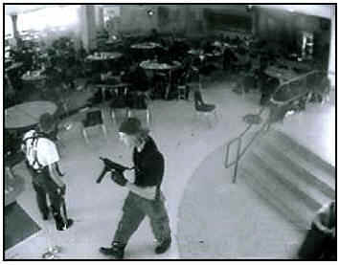

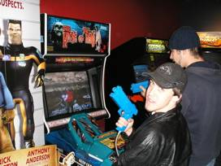

Frameworks and Youth Development
What do we know?
Notes:
Media Depictions of Teens: An Example
Adolescents could learn about media literacy by examining media depictions of young people. Thus, a central question for them to answer would be, "How do the media depict young people?" At least two recent studies have examined that question and provided an answer. In the United States , the studies found, teens are frequently depicted as "kids in crisis." They are seen primarily as problems to be solved or at risk for a host of self-destructive behaviors. (See In Between the Lines: How the New York Times Frames Youth (2000) and Off Balance: Youth, Race and Crime in the News (2001)).
The impact of media messages about kids in crisis is summarized in Fateful Choices , a report from the Carnegie Council on Adolescent Development published in 1992. "The state of adolescent health in America has reached crisis proportions," the authors wrote. "Large numbers of ten-to-fifteen year olds suffer from depression that may lead to suicide; they jeopardize their future by abusing illegal drugs and alcohol, and by smoking; they engage in premature, unprotected sexual activity; they are victims or perpetrators of violence....By age 15, about a quarter of all young adolescents are engaged in behaviors that are harmful to themselves and others" (p. 21).
Does the description reflect the majority of young people? According to the Carnegie report, only 25% of young people in the United States could accurately be described as "in crisis." Media literacy, then, would raise the following questions about the media's depiction of young people: What about the other 75%? Where are their stories being told? Why are the news and entertainment media focused on young people in trouble? How does the skewed depiction of "kids in crisis" shape teens' perceptions of themselves? How does it shape policies implemented by adults?
In a subsequent report, the Carnegie Council espoused media literacy as an effective tool for helping teens detect and reject the undesirable models of themselves they so often see in the media. Such knowledge "may help counter the development of social or peer norms that reinforce and maintain unhealthy behaviors," the group said (p. 118).

Slide 30
Public Conceptual Frames
A decade of research in the social and cognitive sciences strongly suggests that to effectively communicate persuasively about social issues requires an understanding of the conceptual frames ordinary citizens bring to any given policy discussion.
Lochner, A. & Nall Bales, S. (Winter 2006) Framing youth issues for public support. In New Directions for Youth Development, 112, Wiley Periodicals.

Slide 31
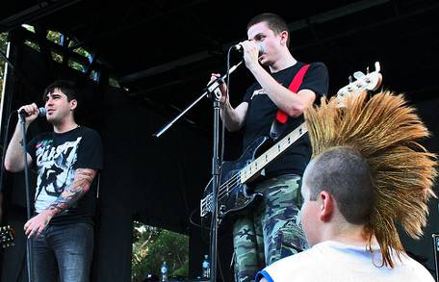
Spin Doctors
The media creates frameworks about youth
Fact-based or Frame-based?

Slide 32
Types of Frames
Episodic
Thematic
Lochner, A. & Nall Bales, S. (Winter 2006) Framing youth issues for public support. In New Directions for Youth Development, 112, Wiley Periodicals.

Slide 33
CRITERIA FOR ASSESSING A FRAMEWORK
To what extent is it's purpose consistent with your intended use?
To what extent does the framework have credibility overall but especially with your intended audience?
To what extent is the framework based on solid research that is relevant to your intended use?
To what extent is the philosophy behind the framework consistent with the philosophy of the work you are doing?
To what extent will the framework likely lead to increased understanding or desired actions?
To what extent can the framework guide accountability efforts? Is there a set of assessment tools one can use?

Slide 34
CRITERIA FOR ASSESSING A FRAMEWORK
To what extent does the framework have communication tools that can help you accomplish your goals? (e.g., handouts, newsletters)
To what extent do key partners in your effort already know the framework or use a competing framework?
To what extent does the framework help you marshal resources needed for success?
To what extent does the framework speak clearly to your intended audience?
To what extent can this framework be bridged/connected to other frameworks already in use?
To what extent, and in what ways, does the framework make your work easier or harder? What will you need to do to make it work?

Slide 35
FRAMES TO BUILD SUPPORT
Private benefits accrue to program participants.
Public benefits accrue to the rest of us.
➔It is possible to exclude non-payers from participating in most outreach programs—and enjoying the private benefits—but it is not possible to exclude non-payers from receiving the public benefits of those programs.
Laura Kalambokidis, Ph.D., University of Minnesota, Creating Public Value With Extension, 2007.

Slide 36
How does an Extension program create public value?
Does it narrow an information gap?
Does it address a crucial concern about fairness?
Does one person’s participation benefit people who do not participate in the program?
Does one person’s participation reduce costs on others?
Does the program avert an undesirable free market outcome?
Laura Kalambokidis, Ph.D., University of Minnesota, Creating Public Value With Extension, 2007.

Slide 38
CONCLUSION
In selecting a framework, or helping others do so, assess its utility against its liabilities.
Recognize that a good framework, especially one with relevant tools, can make a big difference in the speed and ease with which understanding or change can happen.
There are no perfect frameworks - just ones that are more or less useful for specific purposes.

Slide 39
WHAT IS EXTENSION'S ROLE?
To understand different frameworks and use them appropriately
To help people bridge between frameworks as needed
To help people select frameworks that meet specific needs
To develop additional tools that increase the power of specific frameworks
To create frameworks if needed for specific purpose.

Slide 40
WHY EXTENSION?
Extension programs are based on current, defensible, unbiased research.
The exchange between field and campus staff informs the research agenda, ensuring that program development addresses real needs.
The university has built an infrastructure for both research and program delivery. It would be inefficient for another public body to duplicate that infrastructure.
Extension field staff are highly trained educators, who deliver programs using appropriate and effective teaching methods.
Extension program teams collaborate with other public, private, and nonprofit service providers to ensure efficiency and prevent duplication of effort.
Extension recovers costs by charging user fees when appropriate, and by seeking out third-party sponsors.
Others?
Laura Kalambokidis, Ph.D., University of Minnesota, Creating Public Value With Extension, 2007.
Notes:
In Cooperative Extension, we understand the value of our programs to participants.
But “public value” is the value of a program to those who do not directly benefit from the program.

Slide 41
Characteristics of Effective Youth Development Programs
Youth as resources
Ecological Approach
Caring adults and safe environments
Belonging with rules
Flexible and responsive
Long-term
Real work and real responsibility
Experiences resulting in product or presentation

Slide 42
What does it take to assist young people to become healthy, problem-solving, constructive adults?
Youth must:
Find a valued place in a constructive group
Learn how to form close, durable human relationships
Earn a sense of worth as a person
Achieve a reliable basis for making informed choices
Express constructive curiosity and exploratory behavior
Find ways of being useful to others
Believe in a promising future with real opportunities
Cultivate the inquiring and problem-solving habits of the mind
Learn to respect democratic values and responsible citizenship
Build a healthy lifestyle
Great Transitions: Preparing Adolescents for a New Century
Carnegie Council on Adolescent Development

Slide 43
If you were to design a youth development program intended to assist young people to become healthy, problem-solving constructive adults –
what would it look like?

Slide 44
What would it look like?
It would offer opportunities for youth to experience belonging
It would offer opportunities for youth to experience a “hands-on” laboratory
It would offer opportunities for young people to choose
It would offer opportunities to experience what it means to be a citizen

Slide 45
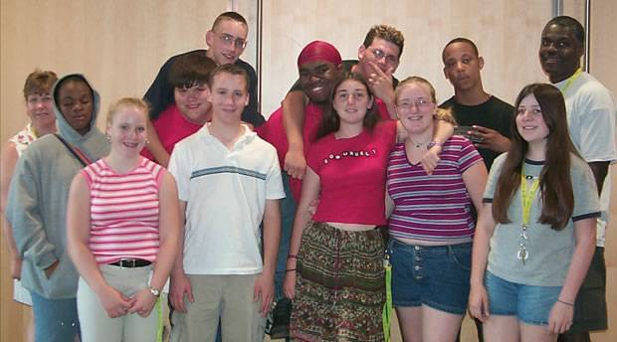
It would look a lot like youth development outreach…
….from the Land Grant University.

